Slide 1
APTShield: A Fine-grained Detection System for Remote Access Trojan in the APT Attacks
Yan Chen

Slide 2



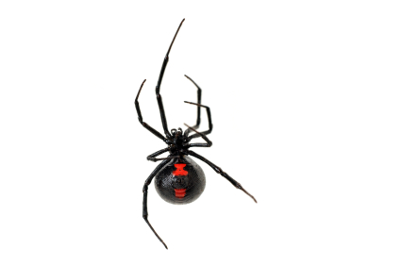



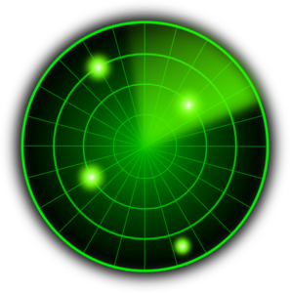




Our Focus
Initial Compromise
Gaining Foothold
Lateral Movement
High Value Asset Acquisition
Malware (e.g. RAT)
Phishing
Exploit
vulnerability
Network scan
Code Repo
Malware
propagation
Attacker
Victim
CONFIDENTIAL
Malicious
Web
Exploit
browser
Database
Behavior based Malware detection
Design a detection mechanism that targets at the post-compromise steps in the APT life-cycle

Slide 3
和市场上主流APT产品的对比
产品 | 检测方法 | 主机监控范围 | APT攻击生命周期
 |  |  | 初始阶段 | 植入后门 | 后续扩散 | 敏感数据泄露
启明星辰 | 基于网络 | Web系统 | 实时检测已知恶意软件 | 无 | 无 | 无
360 | 基于网络和无沙箱主机 | 终端行为检测 系统日志 Web系统 文件系统 邮件系统 | 实时检测已知恶意软件 | 无 | 离线分析 | 离线分析
绿盟 | 基于网络和无沙箱主机 | 内存指令分析 系统日志 Web系统 文件系统 | 实时检测已知恶意软件 | 离线分析 | 离线分析 | 离线分析
阿里云 | 基于网络和无沙箱主机 | 主机行为 系统日志 Web系统 | 实时检测已知恶意软件 | 离线分析 | 无 | 无
天融信 | 基于沙箱的主机 | 文件系统 | 离线分析 | 离线分析 | 离线分析 | 离线分析
科来 | 基于网络和沙箱的主机 | 邮件系统 Web系统 | 实时检测已知恶意软件 | 离线分析 | 离线分析 | 离线分析
安恒 | 基于网络 | Web系统 文件系统 邮箱系统 | 实时检测已知恶意软件 | 无 | 无 | 无
APTShield | 基于沙箱的主机 | 全系统底层监控 | 利用已有检测系统 | 实时检测 | 实时检测 | 实时检测

Slide 4
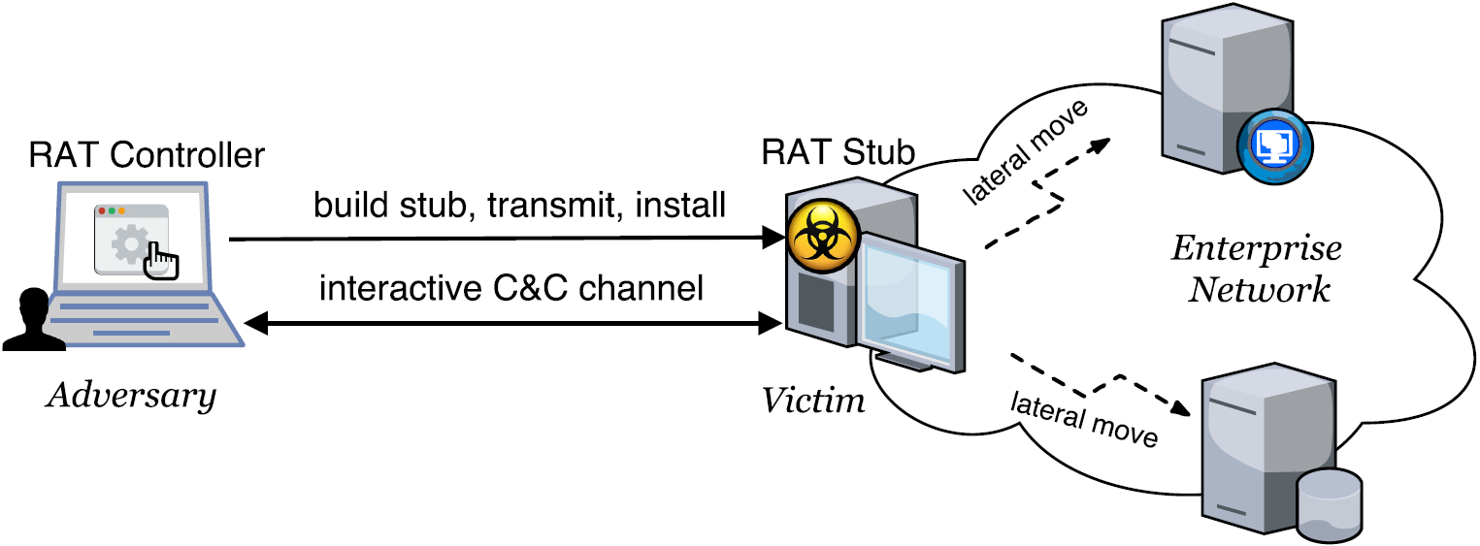
Background about APT Malware
Remote Access Trojan (RAT)
Based on the study of 300+ APT whitepapers, RAT is a core component in an APT attack, and >90% are Windows based.
Allows an adversary to remotely control a system
A complex set of potentially harmful functions (PHFs)
E.g., keylogger, screengrab, remote shell, audiograb
A Windows RAT typically embodies10~40 PHFs.

Slide 5
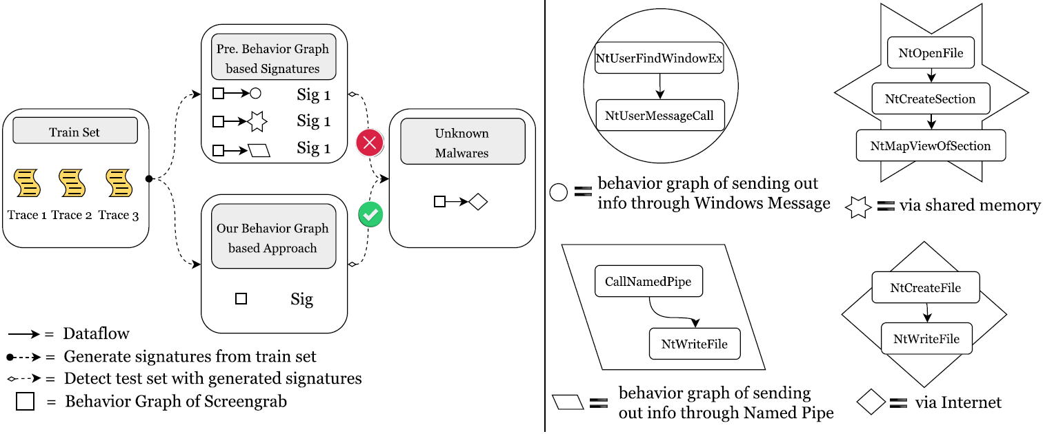
Previous Malware Detection Methods Would Fail RAT Detection

Slide 6
Basic Idea
Observations
# of PHFs possibly embodied in a RAT is limited (10~40).
Ways of implementing a PHF are limited too, in terms of
Core system calls & parameters , and such sequences to exactly define a PHF
→ Possible to define each PHF using system call sequences
Propose PHF-based RAT detection when a program exhibits
A sufficient number of PHFs
RAT-specific resource access characteristics
Advantages: evasion-resilient and semantic-aware
Hard to evade unless attackers find new ways of implementing PHFs
Per PHF detector; semantic-aware; know exactly what activity is going on
Notes:
function-level, ground truth, supervised training,
is a must for adversaries to implement a PHF
A PHF could be exactly defined by a limited set of core system calls.
Separation of signatures for PHFs increases the detection specificity by combining different types of signatures
In each signature sequence, the core system calls are irreplaceable, and the order must be preserved to implement a p

Slide 7
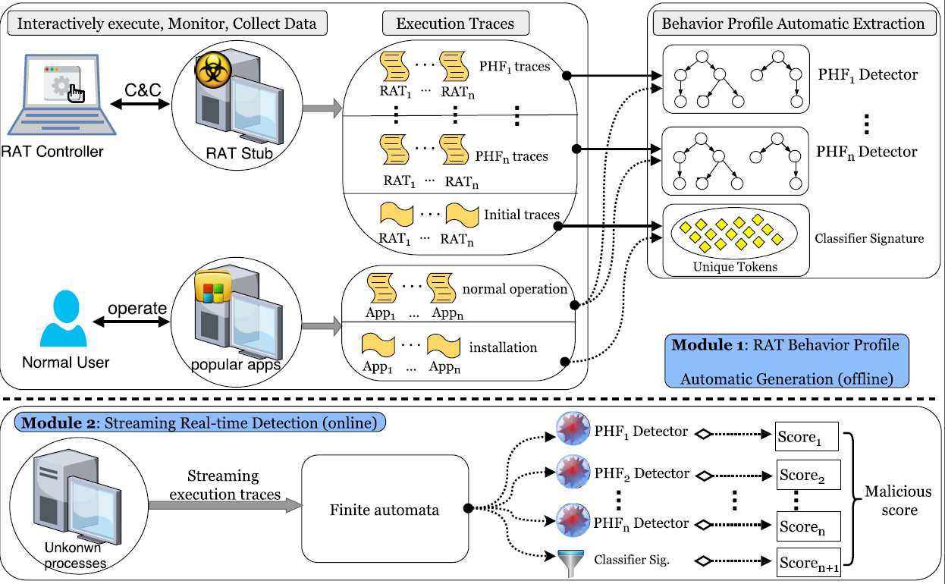
System Architecture
Notes:
function-level, ground truth, supervised training
Generated signatures for both determining the functionality and discerning between malicious and benign

Slide 8
Implementation
Part 1: PHF Detector Generation

Slide 9
PHF Detector Generation - Challenge
Observations
There are limited ways to implement a PHF at the system call level, and RATs tend to implement them quite similarly.
Only quite a small proportion of lengthy malware execution traces are the essential “malicious section”, representing the core function of a PHF
Challenge
How to automatically extract only such essential part from lengthy system call traces to express a PHF?
Notes:
Thus, with tens of RAT samples available, it is feasible to identify all the core system call sequences possibly used for this PHF.
signatures regions of system calls

Slide 10
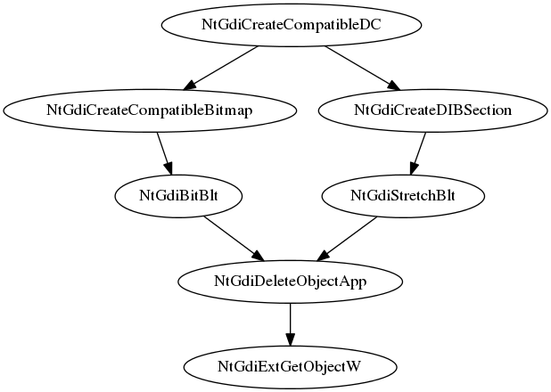
PHF Detector Generation - Solution
Solution
Leverage sequence alignment algorithms borrowed from bioinformatics to identify regions of similarity in system call sequences.
Such similarity regions typically correspond to the execution of similar code.
Build finite automata to model the similarity regions as our PHF detectors
⁞
NtProtectVirtualMemory
NtProtectVirtualMemory
NtGdiCreateCompatibleDC
NtGdiCreateCompatibleBitmap
NtGdiBitBlt
NtGdiDeleteObjectApp
NtGdiExtGetObjectW
NtProtectVirtualMemory
NtProtectVirtualMemory
⁞
⁞
NtDelayExecution NtDelayExecution
NtGdiCreateCompatibleDC
NtGdiCreateDIBSection
NtGdiStretchBlt
NtGdiDeleteObjectApp
NtGdiExtGetObjectW NtDelayExecution NtDelayExecution
⁞
Notes:
Thus, with tens of RAT samples available, it is feasible to identify all the core system call sequences possibly used for this PHF.
signatures regions of system calls

Slide 11
PHF Detector Generation – Solution (cont’d)
Sequence Alignment - Details
Step 1: Local alignment
Preferable when two traces are widely divergent overall but have regions of similarity within long sequences
Tune the classic Smith-Waterman algorithm to take into consideration the data dependencies between system call events and the weight of each event
Step 2: Global alignment
Preferable when the two sequences are similar and of roughly equal size
Tune the Needleman-Wunsch algorithm to our problem
Notes:
Thus, with tens of RAT samples available, it is feasible to identify all the core system call sequences possibly used for this PHF.
signatures regions of system calls

Slide 12
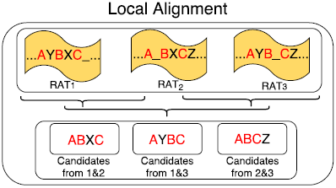
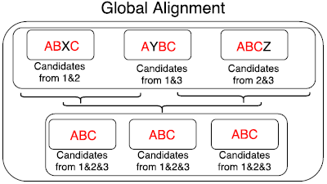
PHF Detector Generation – Solution (cont’d)
Sequence Alignment - Illustration
Notes:
Thus, with tens of RAT samples available, it is feasible to identify all the core system call sequences possibly used for this PHF.
signatures regions of system calls

Slide 13
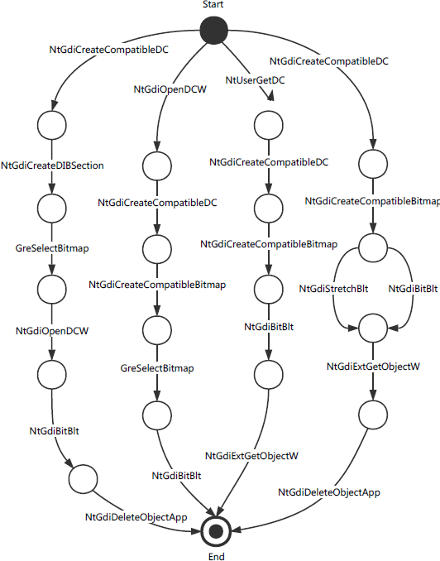
Example of PHF Detector Generated for Screengrab
Screengrab
A path (start, s₁, s₂, …, s_{n}, end) represents one implementation.
Two consecutive system calls in the path are not necessarily consecutive in the trace.
The two system calls must have direct or indirect data flow dependency.
Notes:
function-level, ground truth, supervised training,
is a must for adversaries to implement a PHF
A PHF could be exactly defined by a limited set of core system calls.
Separation of signatures for PHFs increases the detection specificity by combining different types of signatures
In each signature sequence, the core system calls are irreplaceable, and the order must be preserved to implement a
In the rightmost path, NtGdiCreateCompatibleDC
is invoked to create a memory device context (DC); then NtG
diCreateCompatibleBitmap creates a bitmap and place
it in the memory DC; afterwards NtGdiBitBlt copies the
on-screen image into the memory DC; finally, NtGdiExtGet
ObjectW and NtGdiDeleteObjectApp are invoked to do
the rounding-off work, and the task of screen grabbing is completed.

Slide 14
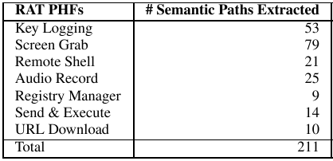
Statistics of PHF Detectors
PHFs currently covered and the number of semantic paths extracted
Key Logging: log all the keys pressed down by the victim and send back to the attacker
Screen Grab: capture the victim’s desktop screen
Remote Shell: remotely open cmd.exe on a victim host and execute arbitrary commands
Audio Record: capture audios with victim’s microphone
Registry Manager: remotely view/modify a victim’s Windows Registry
Send & Execute: upload a local executable file to the victim’s host and automatically execute
URL Download: command the victim to visit a specified website, download an executable file, and then automatically execute it
Notes:
function-level, ground truth, supervised training,
is a must for adversaries to implement a PHF
A PHF could be exactly defined by a limited set of core system calls.
Separation of signatures for PHFs increases the detection specificity by combining different types of signatures
In each signature sequence, the core system calls are irreplaceable, and the order must be preserved to implement a p

Slide 15
Implementation
Part 2: Classifier Signature Generation

Slide 16
Classifier Signature Generation – Greedy Algorithm
Insight
RAT malware often tampers with security-sensitive system settings and registry entries during the initial foothold establishment period while benign programs seldom touch them.
Solution
Develop a greedy algorithm to automatically extract the discriminating tokens which achieve
High coverage: Appear in traces of most RAT malware samples
Near-zero false positive: Seldom appear in traces of benign programs

Slide 17
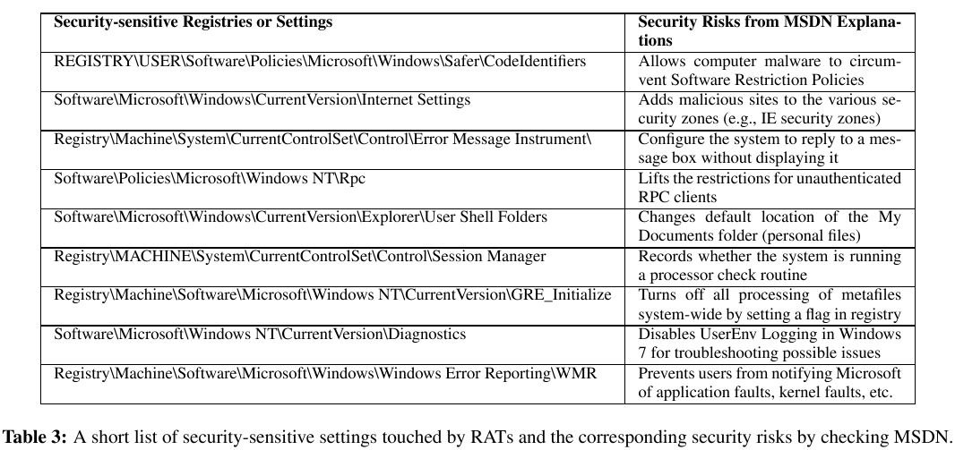
Example of Discriminating Features Extracted
Distinguishing features and their semantics
Notes:
Find the key called “MachineGuid” this key is generated uniquely during the installation of Windows and it won’t change regardless of any hardware swap. It won’t change unless you do a fresh reinstall of Windows. (uniquely Identify A Windows Machine)

Slide 18
An Evaluation Using Third-Party Traces In the Real World

Slide 19
Dataset and Steps Towards Deriving the Attack Graph
Data Summary
35,650,758 system call events; 529 processes involved (30 benign programs)
20 mins processing time; throughput: 1,782,538 records/min
Three processes were reported by our RAT detector
Profile.exe (2) matched with the remoteshell signature
Prodat.exe matched with the screengrab signature
Perform backtracking with the 3 identified processes
Successfully identified all 22 processes (4% out of 529 total processes) involved in malicious activities
Notes:
23KB/s = 1.38MB/min

Slide 20
Attack Graph for the Real-World Scenario

Slide 21
A More Comprehensive Evaluation

Slide 22
RAT Collection
80 RAT controllers are collected from underground hacker forums
Those controllers were cracked and shared in several hacker forums
Each RAT controller could be considered from a unique RAT family, given
Each one is unique in terms of its GUI, the combination of functionalities, and the malware author.
Those controllers are quite notorious and have been involved in famous security incidents in the recent years.
Iran nuclear facility attack, Sony hack, RSA data theft, …
Notes:
RAT-initialization and RAT-per-functionality: 1,271,049 and 5,080,212 system calls

Slide 23
Evaluation of Detection Capability
Experiment 1: Per-PHF traces collected on our own
80 RATs in total = 40 RATs used for training + 40 for test
Capture 80 initialization traces and 560 (i.e., 80*7) per-PHF traces for each RAT → 1,271,049 and 5,080,212 system calls, respectively
Results: 97.9% detection accuracy
Experiment 2: Third-party (from Univ. of New Mexico) benign traces
More than 21 million system calls invoked by 422 processes, corresponding to 27 unique benign applications
Results: 2 false alarms that the two applications Word and Excel performed keylogging operations. No false alarms after initialization signatures are applied.
Notes:
RAT-initialization and RAT-per-functionality: 1,271,049 and 5,080,212 system calls

Slide 24
Evaluation of Detection Capability – cont’d
Experiment 3: Benign traces collected on our own
Select 31 popular Windows applications and perform RAT-like behaviors;
E.g., operate the browser Firefox to download a software from online, install and run it on the machine, which is a behavior quite similar to the PHF “URL Download”
6,861,915 system calls collected
Test each of the 31 Windows application traces against the all 7 PHF sig, and also apply initialization signature
Results: 3.2% (7 out of 217 test results) false positive rate. ZERO false positive rate after initialization signatures are applied.

Slide 25
Evaluation of Robustness against Evasion Attacks
Piggyback Attack
An RAT injects itself into a benign program and then runs in the background whenever the host program is launched
We create 40 mixed traces of benign and RAT processes
Results: 100% detected
A parasite RAT malware still needs to generate execution traces to accomplish an attack, although its traces may be mixed together with those of the host program.
Notes:
System Call Reordering Attack
Obfuscation Attack

Slide 26
Evaluation of Robustness against Evasion Attacks – cont’d
System Call Injection Attack
An attacker inserts arbitrarily functionality-irrelevant system calls into its execution traces.
Results: our system is robust to such attack by nature.
Our per-functionality behavior graphs do not require the system calls contained to be contiguously located in a trace.
Notes:
System Call Reordering Attack
Obfuscation Attack

Slide 27
Evaluation of Robustness against Evasion Attacks – cont’d
System Call Reordering Attack
An attacker may change the order of system calls in the execution path to fool our system.
However, reordering system calls without affecting the semantics of an original program has quite limited applicability.
Strict semantic logic, and data and control dependencies exist among the system calls events which compose a behavior graph to represent a PHF.
Notes:
specifically including randomly inserting branches within a basic block, reordering instructions, encrypting string variables, and dummy code insertion

Slide 28
Evaluation of Robustness against Evasion Attacks – cont’d
Obfuscation Attack
We used a powerful obfuscation tool to perform a series of control flow and data flow obfuscation techniques on RAT samples.
Results: Our system is able to detect all of them, while 35 out of 55 VirusTotal scanners fail to detect them.
Notes:
specifically including randomly inserting branches within a basic block, reordering instructions, encrypting string variables, and dummy code insertion

Slide 29
Conclusion
We proposed a novel, fine-grained, evasion-resilient and real-time RAT detection approach.
With both third-party traces and various attacks evaluated, our approach has demonstrated very high accuracy in real-time.
Notes:
Fine-Grained, Evasion-Resilient and Real-time RAT Detection

